Slide 1
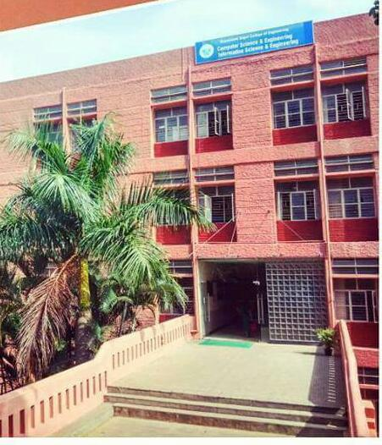

Slide 2
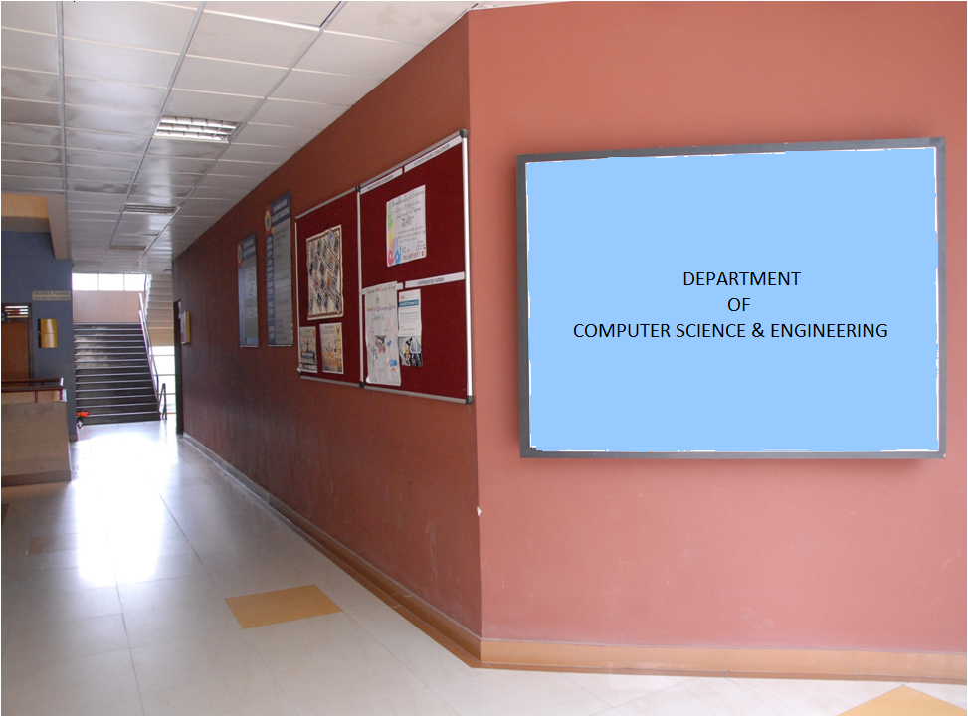

Slide 3

Write a C/C++program to implement
Distance Vector Routing Algorithm
DAYANANDA SAGAR COLLEGE OF ENGINEERING

Slide 4

Distance Vector Routing Algorithm
DAYANANDA SAGAR COLLEGE OF ENGINEERING

Slide 5
_{#include<stdio.h>}
_{struct routing_table}
{ int dist[10], nexthop[10]; };
_{struct routing_table} _{nodes[10];}
_{void init (int n)}
_{{ int i , j;}
_{for(i=0;i<n;i++)}
_{{ for(j=0;j<n;j++)}
_{{ if(i!=j)}
{
_{nodes[i].dist[j]=999;}
_{nodes[i].nexthop[j]= -20;}
}
_{nodes[i].dist[i]=0;}
_{nodes[i].nexthop[i]= -20;}
}
}
}
DAYANANDA SAGAR COLLEGE OF ENGINEERING

Slide 6

Initialization of tables in distance vector routing
 | A | B | C | D | E
A | 0 | 5 | 2 | 3 | 999
B | 5 | 0 | 4 | 999 | 3
C | 2 | 4 | 0 | 999 | 4
D | 3 | 999 | 999 | 0 | 999
E | 999 | 3 | 4 | 999 | 0
 | A | B | C | D | E
A | 0 | - | - | - | -
B | - | 0 | - | - | -
C | - | - | 0 | - | -
D | - | - | - | 0 | -
E | - | - | - | - | 0
22.<number>

Slide 7
_{void update(int i,int j,int k)}
{
_{nodes[i].nexthop[j] = k;}
nodes[i].dist[j] = nodes[i].dist[k]+nodes[k].dist[j];
}
_{void dvr(int n)}
{
_{int i, j, k;}
_{for(i=0;i<n;i++)}
_{for(k=0;k<n;k++)}
_{for(j=0;j<n;j++)}
if(nodes[i].dist[j]>(nodes[i].dist[k]+nodes[k].dist[j]))
_{{ update(i,j,k); }}
}
DAYANANDA SAGAR COLLEGE OF ENGINEERING

Slide 8

Figure 22.16 Updating in distance vector routing
_{K=2 i=0 C Table}
_{j=0 n(A,A) n(A,C) + n(C,A)}
_{n[0,0] > n[0,2] + n[2,0]}
_{0 > 2+2}
_{j=1 n(A,B) n(A,C) + n(C,B)}
_{n[0,1] > n[0,2] + n[2,1]}
_{5 > 2+4}
_{j=2 n(A,C) n(A,C) + n(C,C)}
_{n[0,2] > n[0,2] + n[2,2]}
_{2 > 2+0}
_{j=3 n(A,D) n(A,C) + n(C,D)}
_{n[0,3] > n[0,2] + n[2,3]}
_{3 > 2+999}
_{j=4 n(A,E) n(A,C) + n(C,E)}
_{n[0,4] > n[0,2] + n[2,4]}
_{999 > 2 + 4 update}
22.<number>

Slide 9
_{void main()}
{
_{int n, i, j;}
printf("enter the num of nodes\n");
_{scanf("%d",&n);}
_{init(n);}
printf("enter the distances metric \n");
_{for(i=0;i<n;i++)}
_{for(j=0;j<n;j++)}
_{scanf("%d",&nodes[i].dist[j]);}
_{dvr(n);}
DAYANANDA SAGAR COLLEGE OF ENGINEERING

Slide 10
printf("\nUpdated distance vector tables\n\n");
_{for(i=0;i<n;i++)}
{
_{for(j=0;j<n;j++)}
printf("%d ",nodes[i].dist[j]);
_{printf("\n ");}
}
_{printf("\nNext hop matrix\n");}
_{for(i=0;i<n;i++)}
{
_{for(j=0;j<n;j++)}
printf("%c ",65+nodes[i].nexthop[j]);
_{printf("\n ");}
}
DAYANANDA SAGAR COLLEGE OF ENGINEERING

Slide 11
Updated routing tables after Distance vector algorithm
Distance vector table
Next Hop vector tables
 | A | B | C | D | E
A | 0 | 5 | 2 | 3 | 6
B | 5 | 0 | 4 | 8 | 3
C | 2 | 4 | 0 | 5 | 4
D | 3 | 8 | 5 | 0 | 9
E | 6 | 3 | 4 | 9 | 0
 | A | B | C | D | E
A | - | - | - | - | C
B | - | - | - | A | -
C | - | - | - | A | -
D | - | A | A | - | A
E | C | - | - | C | -

Slide 12
printf("distance vector routing algorithm\n");
for(i=0;i<n;i++)
{
printf(" Updated node %c table\n",65+i);
printf("\t DEST \t DIST \t HOP\n");
for(j=0;j<n;j++)
if(i!=j)
{
printf("\t %c \t %d \t%c\n",
65+j, nodes[i].dist[j], 65+nodes[i].nexthop[j]);
}
DAYANANDA SAGAR COLLEGE OF ENGINEERING

Slide 13
Updated node B table
DEST DIST HOP
A 5 -
B 0 -
C 4 -
D 8 A
E 3 -
Updated node E table
DEST DIST HOP
A 6 C
B 3 -
C 4 -
D 9 C
E 0 E
Updated node A table
DEST DIST HOP
A 0 -
B 5 -
C 2 -
D 3 -
E 6 C
Updated node D table
DEST DIST HOP
A 3 -
B 8 A
C 5 A
D 0 -
E 9 A
Updated node C table
DEST DIST HOP
A 2 -
B 4 -
C 0 -
D 5 A
E 4 -

Slide 14
Tracing the program DVR function for loop
_{i=0 means A node}
_{K=0 Compare A Table}
_{j=0 n(A,A) n(A,A) + n(A,A)}
_{n[0,0] > n[0,0] + n[0,0]}
_{j=1 n(A,B) n(A,A) + n(A,B)}
_{n[0,1] > n[0,0] + n[0,1]}
_{j=2 n(A,C) n(A,A) + n(A,C)}
_{n[0,2] > n[0,0] + n[0,2]}
_{j=3 n(A,D) n(A,A) + n(A,D)}
_{n[0,3] > n[0,0] + n[0,3]}
_{j=4 n(A,E) n(A,A) + n(A,E)}
_{n[0,4] > n[0,0] + n[0,4]}
_{Dvr()}
{
_{int i, j, k;}
_{for(i=0;i<n;i++)}
_{for(k=0;k<n;k++)}
_{for(j=0;j<n;j++)}
if(nodes[i].dist[j] > (nodes[i].dist[k]+nodes[k].dist[j]))
_{{ update(i,j,k); }}
}
DAYANANDA SAGAR COLLEGE OF ENGINEERING

Slide 15
_{i= 0 A node}
_{K=1 means} _{B Table}
_{j=0 n(A,A) n(A,B) + n(B,A)}
_{n[0,0] > n[0,1] + n[1,0]}
_{j=1 n(A,B) n(A,B) + n(B,B)}
_{n[0,1] > n[0,1] + n[1,1]}
_{j=2 n(A,C) n(A,B) + n(B,C)}
_{n[0,2] > n[0,1] + n[1,2]}
_{j=3 n(A,D) n(A,B) + n(B,D)}
_{n[0,3] > n[0,1] + n[1,3]}
_{j=4 n(A,E) n(A,B) + n(B,E)}
_{n[0,4] > n[0,1] + n[1,4]}
_{i= 0 A node}
_{K=2 -----C Table}
_{j=0 n(A,A) n(A,C) + n(C,A)}
_{n[0,0] > n[0,2] + n[2,0]}
_{j=1 n(A,B) n(A,C) + n(C,A)}
_{n[0,1] > n[0,2] + n[2,1]}
_{j=2 n(A,C) n(A,C) + n(C,C)}
_{n[0,2] > n[0,2] + n[2,2]}
_{j=3 n(A,D) n(A,C) + n(C,D)}
_{n[0,3] > n[0,2] + n[2,3]}
_{j=4 n(A,E) n(A,C) + n(C,E)}
_{n[0,4] > n[0,2] + n[2,4]}
_{999 > 2 + 4}
DAYANANDA SAGAR COLLEGE OF ENGINEERING

Slide 16
_{i= 0 A node}
_{K=3 Compares D Table}
_{j=0 n(A,A) n(A,D) + n(D,A)}
_{n[0,0] > n[0,3] + n[3,0]}
_{j=1 n(A,B) n(A,D) + n(D,B)}
_{n[0,1] > n[0,3] + n[3,1]}
_{j=2 n(A,C) n(A,D) + n(D,C)}
_{n[0,2] > n[0,3] + n[3,2]}
_{j=3 n(A,D) n(A,D) + n(D,D)}
_{n[0,3] > n[0,3] + n[3,3]}
_{j=4 n(A,E) n(A,D) + n(D,E)}
_{n[0,4] > n[0,3] + n[3,4]}
_{i= 0 A node}
_{K=4 compares E Table}
_{j=0 n(A,A) n(A,E) + n(E,A)}
_{n[0,0] > n[0,4] + n[4,0]}
_{j=1 n(A,B) n(A,E) + n(B,B)}
_{n[0,1] > n[0,4] + n[4,1]}
_{j=2 n(A,C) n(A,E) + n(B,C)}
_{n[0,2] > n[0,4] + n[4,2]}
_{j=3 n(A,D) n(A,E) + n(B,D)}
_{n[0,3] > n[0,4] + n[4,3]}
_{j=4 n(A,E) n(A,E) + n(B,E)}
_{n[0,4] > n[0,4] + n[4,4]}
DAYANANDA SAGAR COLLEGE OF ENGINEERING

Slide 17
_{i=1 means B node}
_{K=0 Compare A Table}
_{j=0 n(B,A) n(B,A) + n(A,A)}
_{n[1,0] > n[1,0] + n[0,0]}
_{j=1 n(B,B) n(B,A) + n(A,B)}
_{n[1,1] > n[1,0] + n[0,1]}
_{j=2 n(B,C) n(B,A) + n(A,C)}
_{n[1,2] > n[1,0] + n[0,2]}
_{j=3 n(B,D) n(B,A) + n(A,D)}
_{n[1,3] > n[1,0] + n[0,3]}
_{j=4 n(B,E) n(B,A) + n(A,E)}
_{n[1,4] > n[1,0] + n[0,4]}
DAYANANDA SAGAR COLLEGE OF ENGINEERING

Slide 18
_{i= 1 B node}
_{K=1 means} _{B Table}
_{j=0 n(B,A) n(B,B) + n(B,A)}
_{n[1,0] > n[1,1] + n[1,0]}
_{j=1 n(B,B) n(B,B) + n(B,B)}
_{n[1,1] > n[1,1] + n[1,1]}
_{j=2 n(B,C) n(B,B) + n(B,C)}
_{n[1,2] > n[1,1] + n[1,2]}
_{j=3 n(B,D) n(B,B) + n(B,D)}
_{n[1,3] > n[1,1] + n[1,3]}
_{j=4 n(B,E) n(B,B) + n(B,E)}
_{n[1,4] > n[1,1] + n[1,4]}
_{i= 1 B node}
_{K=2 -----C Table}
_{j=0 n(BA) n(B,C) + n(C,A)}
_{n[1,0] > n[1,2] + n[2,0]}
_{j=1 n(B,B) n(B,C) + n(C,A)}
_{n[,1] > n[1,2] + n[2,1]}
_{j=2 n(B,C) n(B,C) + n(C,C)}
_{n[1,2] > n[1,2] + n[2,2]}
_{j=3 n(B,D) n(B,C) + n(C,D)}
_{n[1,3] > n[1,2] + n[2,3]}
_{j=4 n(B,E) n(B,C) + n(C,E)}
_{n[1,4] > n[1,2] + n[2,4]}
_{999 > 2 + 4}
DAYANANDA SAGAR COLLEGE OF ENGINEERING

Slide 19
DAYANANDA SAGAR COLLEGE OF ENGINEERING

